Slide 1


TRAVEL ASSURED
Insights For Effective Marketing Strategy

Slide 2
Objectives: This report aims provide actionable insights to help Marketing strategy, by answering these questions: 1. Are customers more likely to travel often and travel abroad than Non-customers? (Primary) 2. What is the average age of customers? 3. What majority of employment type are customers? 4. What is the average income of customers?
Answering the primary business question:
Total number of people in data = 1,987
Total number of Non-customers = 1,277
Non-customers that are Frequent Flyers & Travelled Abroad = 20
Total Number of Customers = 710
Customers that are Frequent Flyers & Travelled Abroad = 148

Slide 3
Age Insights
Summarizing Age distribution of data:
Average age in data = 30 years
Frequently occuring age = 28 years (506 people aged 28 years)
Age Distribution Range = 25 years – 35 years
Summarizing Age distribution of Customers (710 people):
Customers Average age = 30 years
Frequently occuring age amongst customers = 34years (133 people aged 34 years)
Insights: Out of 148 people aged 33 years in the data, 78 are customers that is an Age to customer ratio 52%.
Out of 266 people aged 34 years in the data, 133 are customers that is Age to customer ratio 50%.
Meanwhile people aged 28years are the highest age count but lowest Age to customer ratio at 20.75%

Slide 4
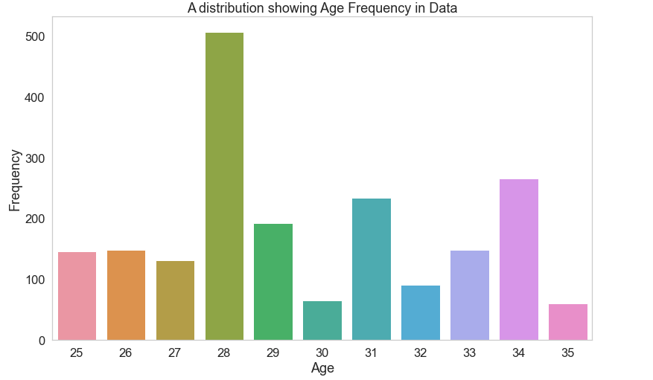
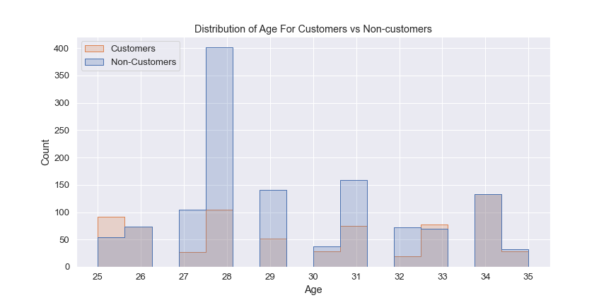

Slide 5
Insights on Employment Type
Total Number of people;
In the data 1,987
In the Private Sector/Self Employed (71.31%) 1,417
In the Government Sector (28.69%) 570
That are Customers 710
In the Private Sector/Self Employed (80.28%) 570
In the Government Sector (19.72%) 140

Slide 6
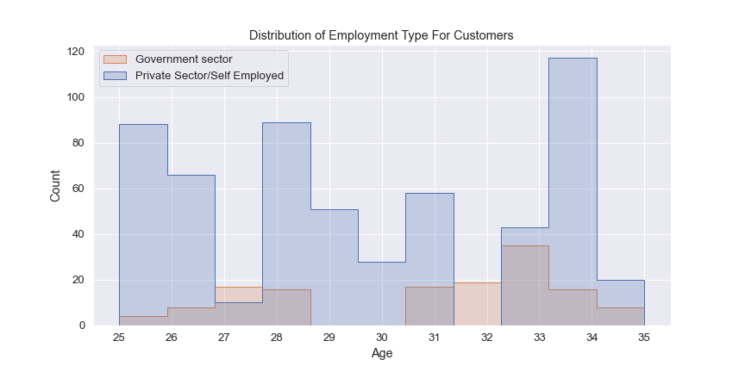
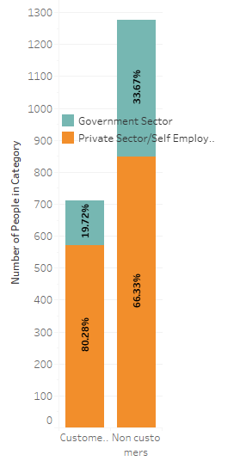

Slide 7
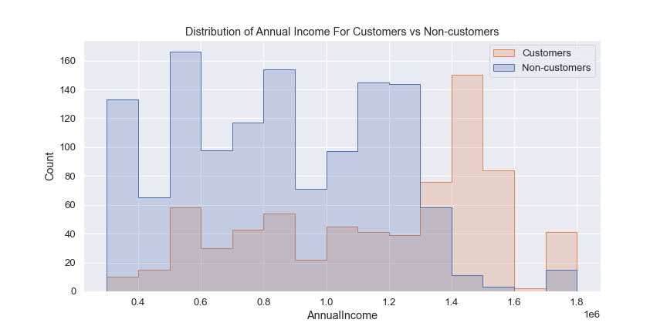
Annual Income Insights Customers Average annual Income = 1,133,239 Annual income range = 300,000 – 1,800,000 64.64% of customers have annual income of greater than 1,000,000

Slide 8
Recommendations
Majority of our customers are within the age bracket of (28years – 34years). People in this age bracket should be the target for adverts.
Advertisement should target people that have an annual income of greater than 1,000,000.
Advertisements should target people in the Private Sector/Self Employed sector.
78% People with 3-6 family members tend to buy our insurance. Advertisements should target people in that demographics.

